Slide 1
Universal Customer View
Big Data Demonstration

Slide 2
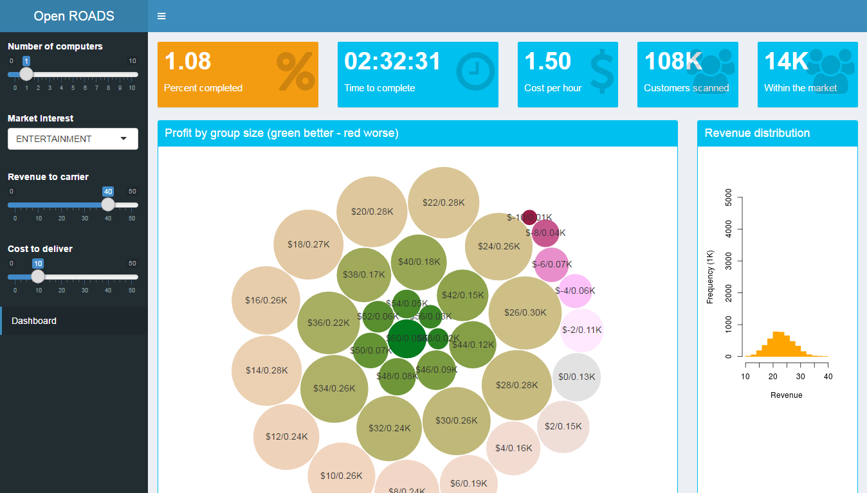
Persona Driven Cross Sell
South Asian operator is running “first month free streaming music service” promotion.
Identify customers, who are likely to continue with their subscription after the promotion period ends.
10M customer CRM records*
100M per service per user records*
External demographic data
Market Interest
Revenue to carrier
Cost to Deliver
Run
Monte Carlo
Simulation
Group customers based
on profit
*Simulated data

Slide 3
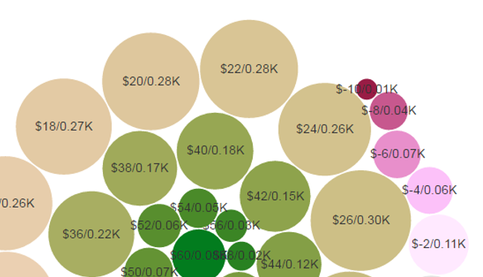
Persona Driven Cross Sell
Color of circle: Green circles represent relatively positive CLTV changes, red ones negative.
Size of the circle: Number of customers relative to total.
First figure: Increase in CLTV. In this case, $18 increase on already existing CLTV of .
Second figure: Number of customers in thousands, who share the same CLTV change. In this case, 110 customers.

Slide 4










Solution Architecture
Microsoft Azure
Data
Storage
Hadoop
Cluster
Controller
UI Shinny
Statistics

